Slide 1
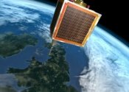
Saratoga
fast data transfer… from space
draft-wood-tsvwg-saratoga
Wood, Eddy, Smith, Ivancic, Jackson, McKim
NASA Glenn Research Center,
Surrey Satellite Technology Ltd (SSTL)
Lloyd Wood
June 2013
Notes:
Some slides contain additional notes with further information.

Slide 2
Saratoga is a transfer protocol that is...
scalable
Can transfer kilobytes, megabytes, gigabytes, petabytes, exabytes... suitable for exascale computing.
fast
intended to run as quickly as possible across dedicated links. (Can support congestion control for shared use.)
reliable
while providing high-speed delivery of content.
robust
Originally developed for use from space.

Slide 3
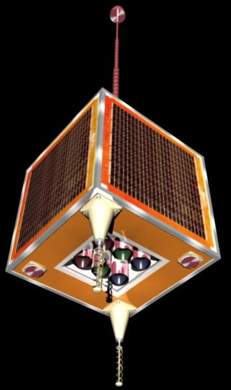
Short summary of Saratoga
A simple, fast data transfer protocol ideal for file transfers across private links or for delay/disruption-tolerant networks (DTNs).
In use by Surrey Satellite Technology Ltd (SSTL) to transfer remote-sensing imagery from its IP-based DMC satellites.
NASA Glenn improved base Saratoga design to create a new version of Saratoga described to the Internet Engineering Task Force (IETF): draft-wood-tsvwg-saratoga.
We have developed and tested Saratoga with RTEMS-based computers on SSTL’s UK-DMC satellite and in a ground-based testbed.
There are multiple protocol implementations.
UK-DMC
satellite
first generation
Notes:
Saratoga: A Scalable File Transfer Protocol, Lloyd Wood, Wesley M. Eddy, Will Ivancic, Jim McKim and Chris Jackson, work in progress as an internet-draft, draft-wood-tsvwg-saratoga.
RTEMS: Real-Time Executive for Multiprocessor Systems. An embedded operating system.

Slide 4
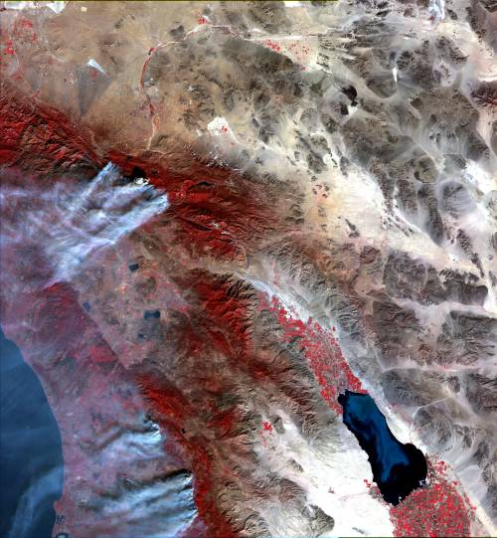
Disaster Monitoring Constellation (DMC)
www.dmcii.com
SSTL build and help operate an international constellation of small sensor satellites.
These satellites orbit in a sun-synchronous orbital plane for rapid daily large-area imaging (640km swath width with 32m resolution). Can observe effects of natural disasters. Imaged the effects of Hurricane Katrina and the Indian Ocean Tsunami.
Government co-operation. Each government finances a ground station in its country and satellites. Ground stations are networked together. Newer satellites are added to the constellation over time. Now on second generation of satellites, with added commercial investment.
fires in California, 28 October 2003 (UK-DMC)
Notes:
DMC resolution can be good enough to determine what’s in a farmer’s field, to track growth of communities over time where you don’t have reliable census data, and even to track the movement of locust swarms.
The Turkish BilSat satellite differs from the usual DMC design in a number of ways, and has a 26m resolution area-array camera for DMC imaging alongside a higher-resolution 12m camera, with onboard JPEG2000 compression. DMC operational frequencies are S-band; BilSat TT&C can use UHF/VHF.
The Chinese contribution to the DMC (Tsinghua-1) has other enhancements, including an extra, high 4m-resolution, camera requiring an additional, faster, X-band downlink in addition to the usual DMC 8Mbps S-band downlink.
Two more Nigerian DMC satellites, a satellite funded by a Spanish commerical company, and a second UK satellite have been announced.

Slide 5
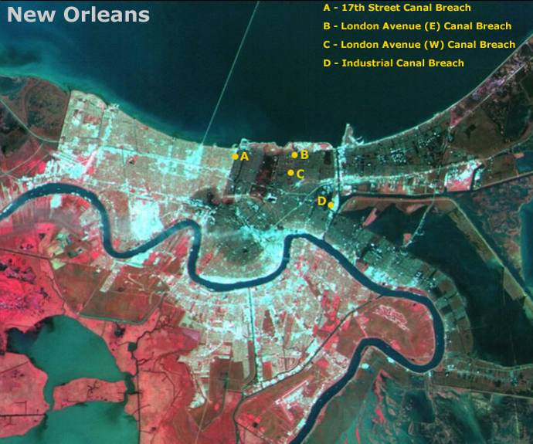
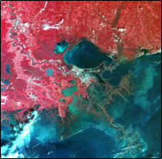
DMC in use: after Hurricane Katrina, 2005
In this false-color image, dry land is red. Flooded and damaged land is shown as brown.
Small part of an image from the NigeriaSat-1 satellite, taken on Friday 2 September 2005, for US Geological Survey.
DMC is working as part of the United Nations International Charter for Space and Major Disasters.
All imagery delivered by using Saratoga over UDP/IP.
Saratoga is in daily operational use.
www.dmcii.com
Notes:
This image is detail from a larger image. See the DMC International Imaging website for more details.
http://www.dmcii.com/
DMC International Imaging is a wholly-owned internal spinoff of SSTL.
Information on the International Charter for Space and Major Disasters is at:
http://www.disasterscharter.org/
A number of space agencies are members of this charter, as is the US National Oceanic and Atmospheric Administration.

Slide 6
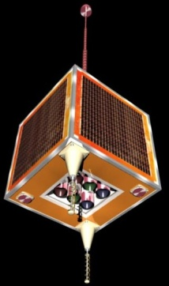
Saratoga use in satellite operations
Each DMC satellite has multiple onboard computers. The Solid State Data Recorders (SSDRs) control cameras and store and download images using Saratoga over UDP/IP.
DMC downlink for image files is a minimum of 8.1Mbps using S-band. Newer satellites also have 20/40/80 Mbps at X-band for added hi-res cameras; faster downlinks (100+ Mbps) are in use on second generation. Uplink is a minimum of 9600bps for command and control. Uplink speeds have also increased… but only to 38400 bps.
Very asymmetric; 850:1 or worse downlink/uplink ratio.
minimum
8.1 Mbps
downlink
minimum
9600bps uplink
As much data as possible must be transferred during a pass over a ground station. Passes may be up to fourteen minutes, depending on elevation. At 8Mbps from first generation, that’s about 650MB of useful data that can be transferred in a high pass – if the downlink is filled at line rate with back-to-back packets. Link utilization and efficiency really matter. SSDRs take scheduled turns filling downlink.
ground station
LAN
Notes:
Exact bit rate is 8140800bps. This happens to be 212 * 38400 bps (the low-rate downlink).
Serial stream encoding of IP packets is a standard form of HDLC (High-level Data Link Control) with a four-byte Frame-Relay header before each IP packet. This design decision was made for earlier UoSAT-12 IP work with Keith Hogie, and is described in:
K. Hogie, E. Criscuolo and R. Parise, Using standard Internet Protocols and applications in space, Computer Networks (Elsevier), special issue on Interplanetary Internet, vol. 47 no. 5, pp. 603-650, April 2005
More details are in:
Using Internet nodes and routers onboard satellites, Lloyd Wood, Will Ivancic, Dave Hodgson, Eric Miller, Brett Conner, Scott Lynch, Chris Jackson, Alex da Silva Curiel, Dave Cooke, Dan Shell, Jon Walke and Dave Stewart, special issue on Space Networks, International Journal of Satellite Communications and Networking, volume 25 issue 2, pp. 195-216, March/April 2007.
http://personal.ee.surrey.ac.uk/Personal/L.Wood/cleo/

Slide 7
Simple delivery mechanism
*
*
*
*
STATUS acknowledgement pacing is set by request pacing
DATA packet
*
DATA packet requesting STATUS ack update
STATUS packet sent as requested

Slide 8
Basic Saratoga design
Flood data packets out as fast as you can. No specified congestion control, since usual use has data only going one hop over a private link. (No specified timers means no timeouts, so Saratoga will also be good for the very long propagation delays found in deep space.)
Every so often while flooding, ask for acknowledgement STATUS from file receiver. Receiver can also send acks if it thinks it needs to, or to start/restart/finish transfer.
STATUSes are Selective Negative Acknowledgements (SNACKs) indicating received packets and any gaps to fill with resent data (and with enough information so that intelligent sender rate control or congestion control can be optionally added if needed locally).
Other telemetry can be multiplexed in as IP traffic.
That’s it. But just how big are the files being transferred?

Slide 9
Filesizes can be large, streams can be fast
For the DMC satellites, imaging files are big – typically up to a few gigabytes at 32m resolution; larger for newer cameras. So we believe there is a need to transfer large amounts of sensor data – gigabytes and up. This will only increase over time as sensors and network links improve.
But ad-hoc/sensor nets also need to transfer small files; guessing a range limits use.
So we allow a range of file-descriptor pointers to be advertised: 16/32/64/128-bit file descriptors.
If file is less than 64KiB, use 16-bit offsets. If file is larger but less than 4GiB, use 32-bit offsets…
16-bit offsets are always supported. Others are optional. Draft diagrams are all 32-bit, because that fits 80 columns.
128-bit descriptors are useful for petabyte-sized file transfers or for fast high-speed streams. Future-ready.

Slide 10
Saratoga packets
BEACON
Sent periodically. Describes the Saratoga peer:
- Identity (e.g. EID)
- capability/desire to send/receive packets.
- max. file descriptor handled: 16/32/64/128-bit.
REQUEST
Asks for a file via ‘get’, directory listings, deletes.
METADATA
Sent at start of transaction.
Describes the file/bundle:
identity for transaction
file name/details, including size.
descriptor size offsets to be used for this file
(one of 16/32/64/128-bit pointer sizes.)
Uses descriptor of chosen size to indicate offset for data segment. May request an ack.
DATA
Selective negative ack (SNACK). ‘Holestofill’ hole edge offsets indicate missing ‘holes’ in data.
STATUS

Slide 11
Saratoga sessions: ‘put’
file-receiver
file-sender
BEACON
Beacons (optional);
show filesize capabilities.
BEACON
METADATA
Describes chosen file.
STATUS
DATA
Ack indicates reception.
DATA
Lost data creates hole in copy at receiver.
lost
DATA
DATA
DATA
Ack requested and
selective negative ack sent describing hole to be filled with resend.
*
STATUS
DATA
DATA
DATA
Empty ack indicates transaction is complete.
STATUS
diagram assumes short delay

Slide 12
Saratoga sessions: ‘get’
file-receiver
file-sender
BEACON
Beacon heard (optional).
REQUEST
‘getdir’ can request file list.
METADATA
STATUS
File list sent as file…
DATA/’holestofill’ STATUS exchange omitted
REQUEST
‘get’ requests a file.
METADATA
STATUS
File is described.
DATA
METADATA is acked. File data is streamed out directly after METADATA, without waiting for ack.
DATA
DATA
Sender continues to send out DATA.
SNACK requested and sent.
DATA
DATA
*
STATUS
diagram assumes short delay

Slide 13
Heart of a Saratoga transfer session
start
finish
send STATUS packet and repeat cycle until transfer completes
yes
repeat
until
STATUS
requested
or until
end of
DATA
done?
no
DATA
packet
STATUS packet requested
regularly while sending DATA
no
failure
in session?
STATUS request at intervals or at end of DATA
DATA
packet
requesting STATUS
*
STATUS
packet
yes
generated
at sender
generated
at receiver
send error

Slide 14
Congestion control can be added
Enough information is sent and received between peers to support congestion control, if needed.
Congestion control is not mandated; primary use case across dedicated private link filled by single flow doesn’t need it.
But this could be implemented if required for traffic across the public, shared, terrestrial Internet.
Sender-based ‘TCP friendly’ congestion control mechanisms have been studied.
Described in draft-wood-tsvwg-saratoga-congestion-control and draft-eddy-tsvwg-saratoga-tfrc.
Simply rate limiting Saratoga to a set speed, rather than the full output rate of an interface, is of more immediate interest to private users for predictable performance.

Slide 15
Other optional Saratoga features
Streaming of data is supported. This allows Saratoga to be used for real-time delivery outside the file-based paradigm.
Uses link-local multicast to advertise presence and discover peers. Data can be sent to local multicast addresses for multiple peers to receive.
Can support checksums for reliable file delivery.
Also supports UDP-Lite for when errors in data received can be tolerated. Header content is always checked so that the information about the data is error-free. UDP-Lite use is expected to be rare; reliable transfers of data are the norm.

Slide 16
Optional DTN bundling
Saratoga can also support Bundle Protocol delivery for Delay-Tolerant-Networking (DTN), as a reliable “bundle convergence layer.”
This is described in draft-wood-dtnrg-saratoga.
NASA Glenn conducted the first tests in space of the ‘Interplanetary Internet,’ from SSTL’s UK-DMC satellite, by sending DTN bundles of imaging data from orbit using Saratoga (2008).
Bundle support is now seen as of little value to Saratoga users. Not a key feature for these DTNs.
Notes:
Optional bundling support is described in:
Using Saratoga with a Bundle Agent as a Convergence Layer for Delay-Tolerant Networking, Lloyd Wood, Wesley M. Eddy, Will Ivancic, Jim McKim and Chris Jackson, work in progress as an internet-draft.
Further details of testing in:
Will Ivancic, Wesley M. Eddy, Dave Stewart, Lloyd Wood, James Northam and Chris Jackson, 'Experience with delay-tolerant networking from orbit', peer-reviewed journal paper, International Journal of Satellite Communications and Networking, special issue for best papers of the Fourth Advanced Satellite Mobile Systems Conference (ASMS 2008), vol. 28, issues 5-6, pp. 335-351, September-December 2010.
Lloyd Wood, Will Ivancic, Wesley M. Eddy, Dave Stewart, James Northam, Chris Jackson and Alex da Silva Curiel, 'Use of the Delay-Tolerant Networking Bundle Protocol from Space', conference paper IAC-08-B2.3.10, 59th International Astronautical Congress, Glasgow, September 2008, vol. 5, pp. 3123-3133. Later published as NASA Technical Memorandum TM-2009-215582.

Slide 17
Saratoga can provide reliable transfers
Saratoga uses the UDP checksum to cover header and payload. This is consistent but not that strong (one’s-complement), and not end-to-end.
An optional end-to-end checksum (CRC32c, MD5 or SHA-1) over an entire file being transferred can increase confidence that a reliable copy has been made, or that file fragments have been reassembled correctly. Strong link-layer checksums are optional.
The Delay-Tolerant Networking research group “Bundle Protocol” and its convergence layers lack any reliability checks. We have spent time examining that shortfall and proposing ways of adding reliability into the DTNRG bundle protocol.
Notes:
How reliability could be added to the DTNRG bundle protocol is described in:
Checksum Ciphersuites for the Bundle Protocol, Wesley M. Eddy, Lloyd Wood and Will Ivancic, work in progress as an internet-draft, draft-irtf-dtnrg-bundle-checksum.

Slide 18
Why Saratoga instead of TCP?
For high throughput and link utilization on dedicated links, where a single TCP flow cannot fill the link to capacity.
For links and link use where TCP’s assumptions about loss/congestion/competition simply don’t hold.
Able to cope with high forward/back asymmetry (>850:1).
Long delay use – eventually TCP will fail to open a connection because its SYN/ACK exchange won’t complete. TCP has many unwanted timers.
Simplicity. TCP is really for a conversation between two hosts; needs a lot of code on top to make it transfer files. A focus on just moving files makes e.g. sequence nos. simpler. Having SNACKs means that handling sequence number wraparound when streaming becomes easy.

Slide 19
Saratoga vs TCP – a single flow
link rate
header overheads
Saratoga
transfer rate Mbps
channel errors leads to
packet losses and resends
TCP congestion
avoidance mode
TCP presumes that any loss indicates congestion and slows its rate
TCP
TCP
slow start mode
TCP fast recovery
halves its rate
link capacity
unused by TCP
time t

Slide 20
Our approach to DTN networking
We believe that the Internet Protocol (IP) is useful for operational use in delay or disruption-tolerant and in sensor networks. IP runs across many links already; its engineering is well-understood.
How IP is used differs between the public Internet and private space links (shared contention vs dedicated scheduling models – this discourages TCP reuse) but the base IP protocol is the same.
DMC shows use of IP both on the ground and in space, with the ground station acting as a gateway between different kinds of link behaviour and link use. DMC satellites provide a real DTN scenario, with long disruptions between contacts.

Slide 21
Possible applications of Saratoga
In any private IP-based network where data must be moved as rapidly as possible over dedicated links.
In private sensor networks generating large quantities of data and moving it from sensors to central processing, such as in remote-sensing satellites and for radio astronomy.
In delay-tolerant networks (DTNs).

Slide 22
Current status of Saratoga
SSTL’s Saratoga remains in daily use on DMC satellites for mission-critical downloads of Earth imagery. Ground and space implementations.
Other implementations underway.
Public Saratoga perl implementation and Wireshark plugin for interoperability testing of private implementations.
Notes:
More details at:
http://saratoga.sourceforge.net/
http://personal.ee.surrey.ac.uk/Personal/L.Wood/saratoga
Will Ivancic, Wesley M. Eddy, Dave Stewart, Lloyd Wood, James Northam and Chris Jackson, 'Experience with delay-tolerant networking from orbit', peer-reviewed journal paper, International Journal of Satellite Communications and Networking, special issue for best papers of the Fourth Advanced Satellite Mobile Systems Conference (ASMS 2008), vol. 28, issues 5-6, pp. 335-351, September-December 2010.
Lloyd Wood, Will Ivancic, Wesley M. Eddy, Dave Stewart, James Northam, Chris Jackson and Alex da Silva Curiel, 'Use of the Delay-Tolerant Networking Bundle Protocol from Space', conference paper IAC-08-B2.3.10, 59th International Astronautical Congress, Glasgow, September 2008, vol. 5, pp. 3123-3133. Later published as NASA Technical Memorandum TM-2009-215582.

Slide 23
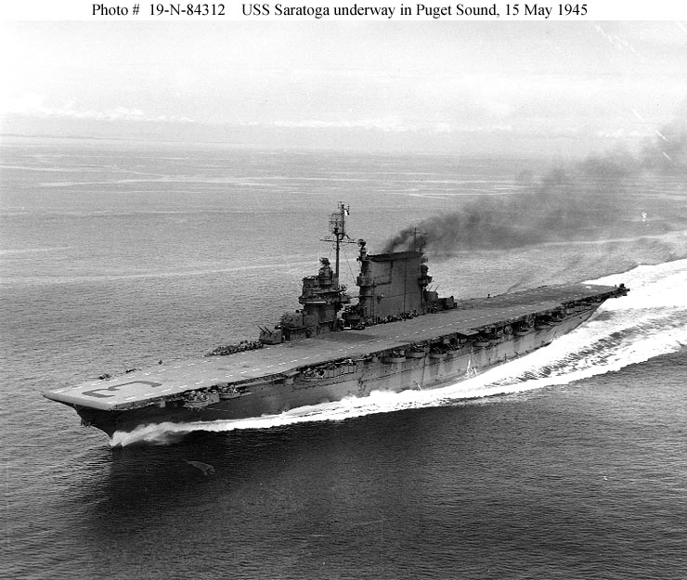
What prompted the name Saratoga?
USS Saratoga (CV-3) is sunk off Bikini atoll.
Chris Jackson of SSTL has dived there.

Slide 24
http://tools.ietf.org/html/draft-wood-tsvwg-saratoga
http://saratoga.sf.net/
with thanks to
Will Ivancic, Wes Eddy, Jim McKim
Chris Jackson and Charles Smith
Notes:
More details at:
http://saratoga.sourceforge.net/
http://personal.ee.surrey.ac.uk/Personal/L.Wood/saratoga

Slide 25
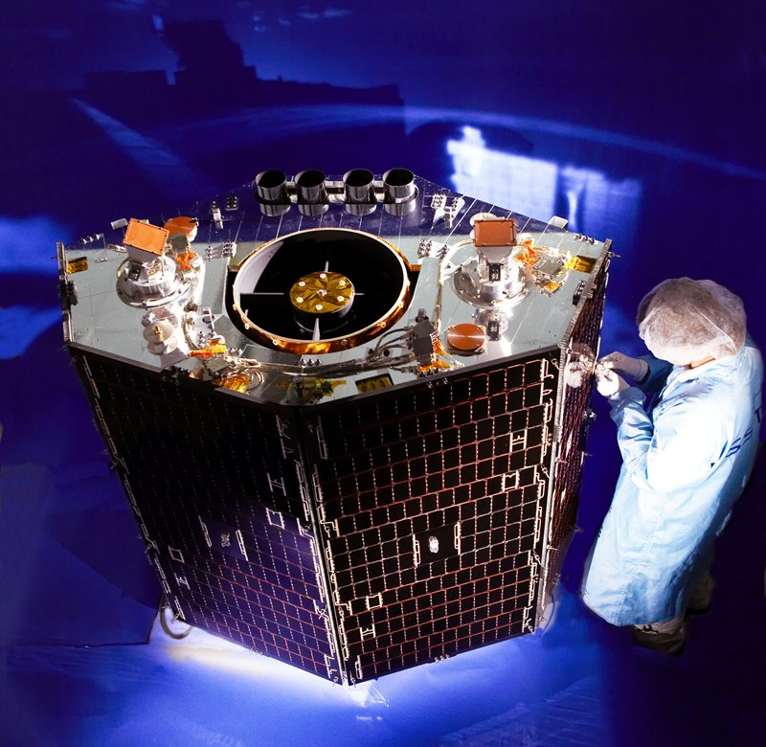
NigeriaSat-2 (launched 2011)
DMC second generation

